Slide 1


Magnetic Mirror Effect in Magnetron Plasma
18BEM0145 - Sashi Kant Shah 18BME2104 - Kaushal Timilsina 18BME2109 - Hrishav Mishra
B.Tech. Mechanical Engineering
Capstone Project Presentation
School of Mechanical Engineering
Guide: Prof. / Dr. Sitaram Dash
Date of Presentation: 03/30/2022

Slide 2
Project Status
Review I
Studied Plasma physics
Set up the Problem
Set up the algorithm
Review II:
Running Plasma Simulation
Checks:
Sampling check Update check
Study 1 Varying Electric Field Constant Magnetic Field Plots and Animations
Review III
Study 2 Parabolic Density Function Radial Electric Field Configuration (Mimicing an Electrode) Helmholtz coil magnetic field configuration / Magnetic Mirror configuration(parabolic B along z-axis configuration for ∇ B || B) Plots and Animations

Slide 3
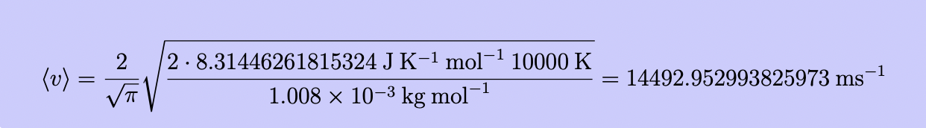
Checks
To verify that our program is working correctly, we perform some checks.
Sampling
Update
1.1 Sampling
As of now we our sampling of particle speeds is based on the Maxwell-Boltzmann distribution, that we have defined previously. We now check if the average speeds of the particles agrees with the calculations done by hand based on the plasma temperature. We recall the Maxwellian density function that we defined earlier.
We take the following data and sample 100 particles
Temperature (T) = 10,000 K Relative Atomic weight of Hydrogen(m) =1.008 g/mol
Universal Gas Constant (R) = 0.831 JK-1mol-1
For the Hydrogen atom particle distribution, we get
B.Tech. Mechanical Engineering/Production and Industrial Engineering/Mechanical with Specialization in Energy Engineering – Second Review Presentation - SMEC

Slide 4
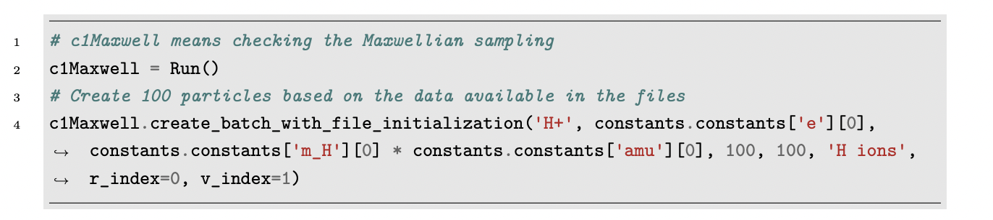
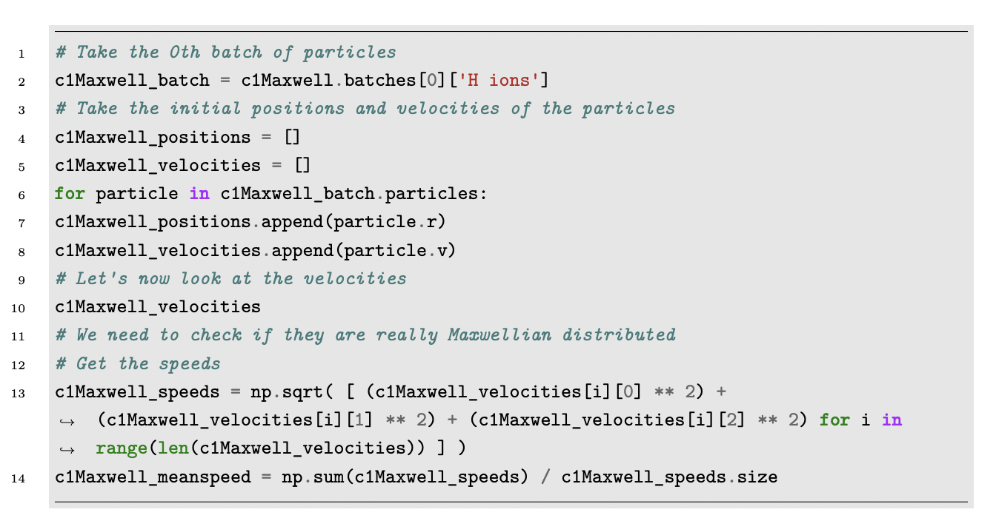
Initialization
Inspection
We get an average speed of the distribution to be:
14202.7645 ms⁻¹

Slide 5
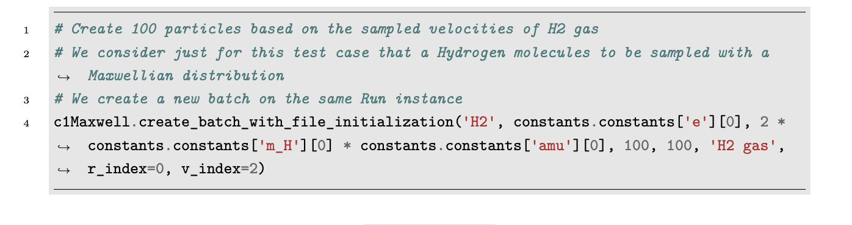
We see that the mean average speed of the sampled distribution and that expected from the analytic expression are close; in fact within 2.0431% error.
Initialization
Hydrogen molecule sampling
We get the same temperature for this distribution but the relative molecular mass is doubled

Slide 6
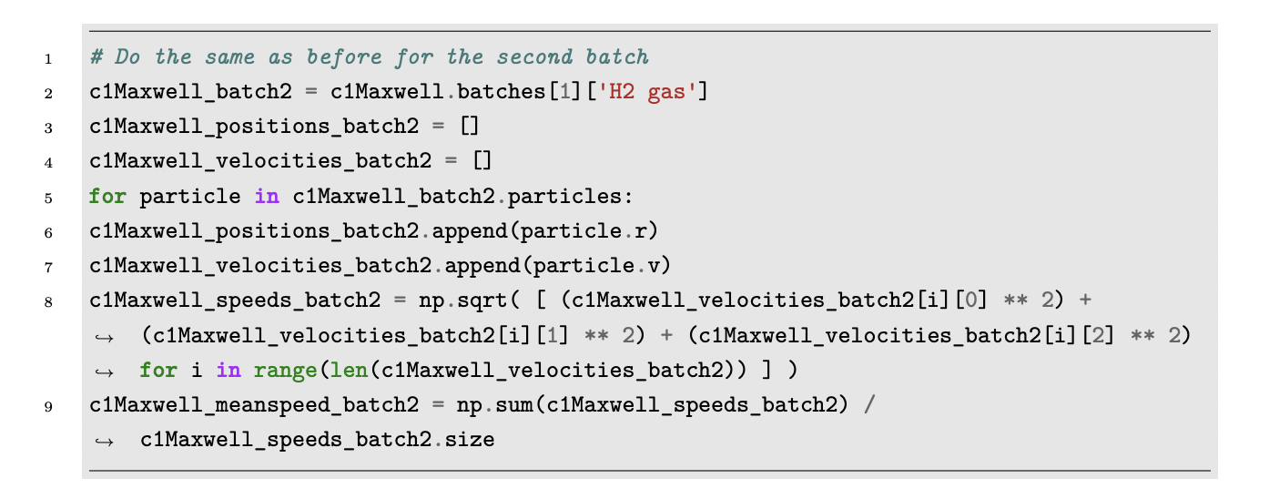
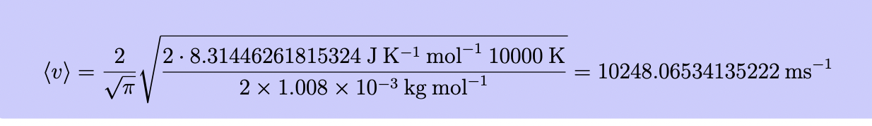
Inspection
We get an average speed of the distribution to be: 10149.754 ms⁻¹ .
From the analytic calculation for the Hydrogen molecule particle distribution, we get
The mean average speed of the sampled distribution and that from the analytic expression are close for this distribution within 0.968% error.

Slide 7
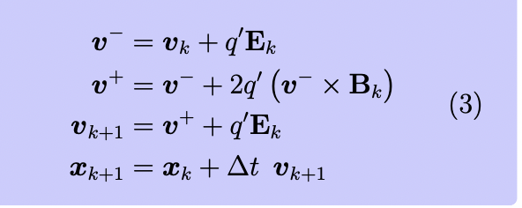
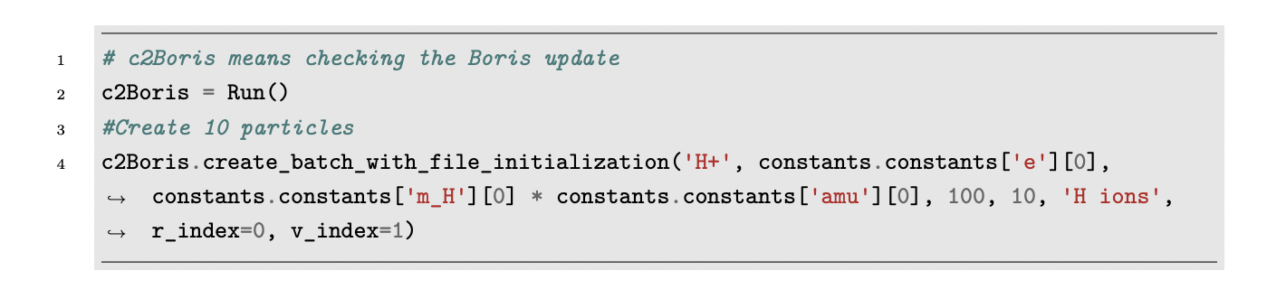
1.2 Update
We recall the Boris Algorithm, that we use to update the particles in the plasma simulation.
where q 0 = q m /∆t 2 . To verify that the simulation works as we expect it to, we perform a calculation and compare it to the output of an algorithm.
Initialization

Slide 8
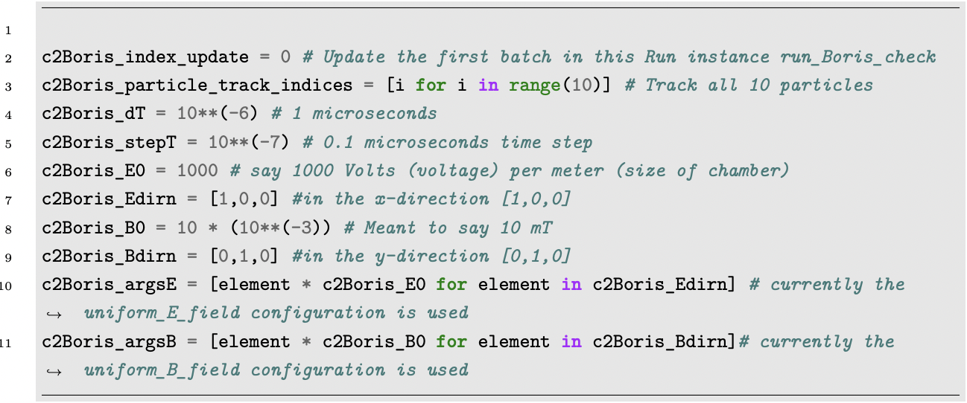
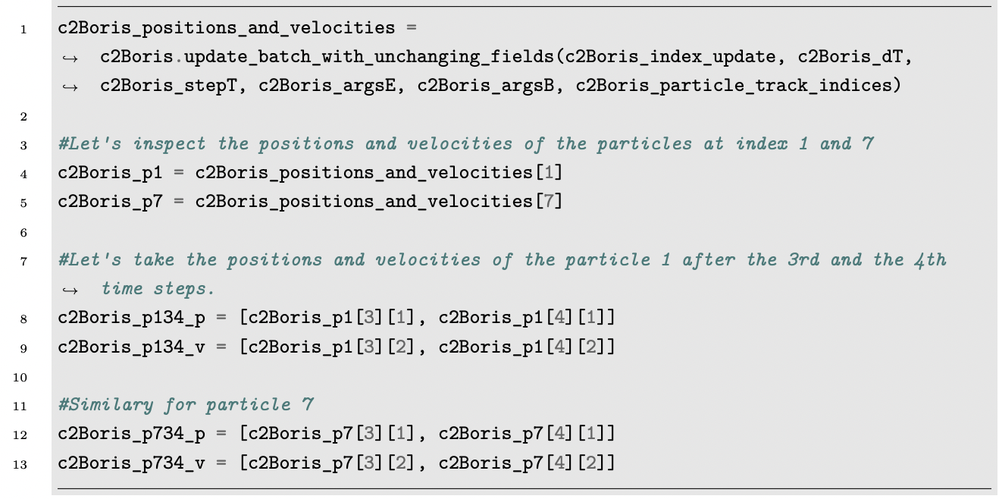
Update input data
We take the following input data:
100 particles of Hydrogen Electric field of 1000 Vm-1 in x direction [1,0,0] Magnetic field of 10 mT in y direction [ 0,1,0] Duration of simulation 1μs Duration of 1 step of update = 0.1 μs

Slide 9
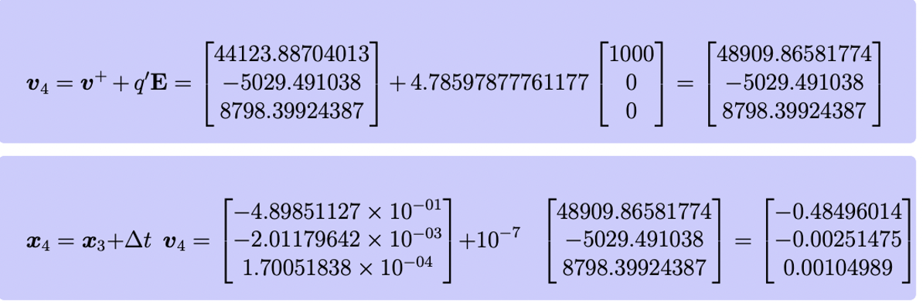
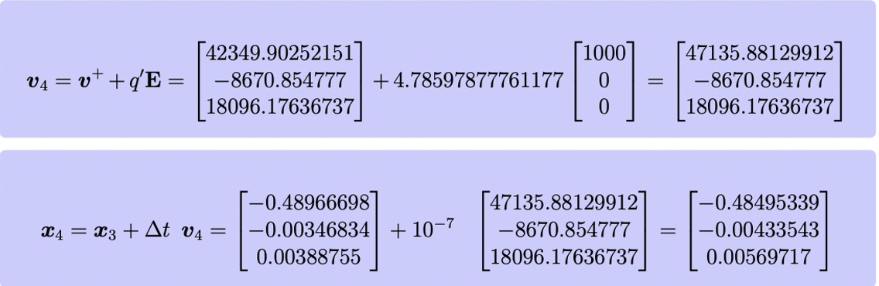
We see that the values for x3, x4, v3 and v4 for particle 1 are close (the latter digits differ due to the differing precision of calculations); i.e. the same when done by hand and in the program.

Slide 10
Update
We see that the values for x3, x4, v3 and v4 for particle 1 are close (the latter digits differ due to the differing precision of calculations); i.e. the same when done by hand and in the program.
Similarly, for particle 7. After the 3rd step of the update, the velocity of the particle was:
and after the 4th update, it changed to:
Its position after the 3rd step of the update was
which was updated after the 4th step of the update to:

Slide 11
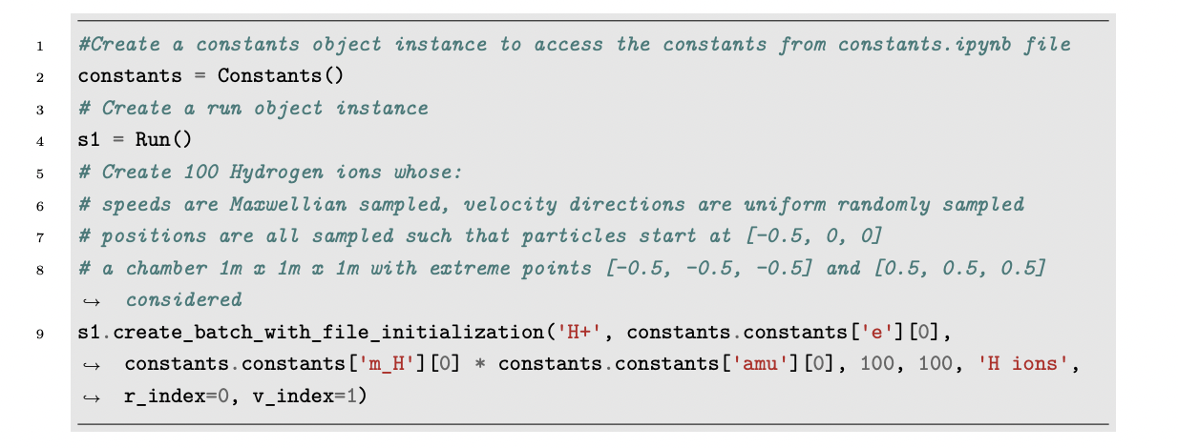
Plasma Stream
×
We now create our first plasma system, where we can change certain parameters of the fields; so as to simulate controlling plasma in a chamber by changing the electric and magnetic fields as required.
We take the following input data:
100 ions of Hydrogen speeds are Maxwellian sampled with 10,000 K Temperature
velocity directions are uniform randomly sampled
positions are all sampled such that particles start at [-0.5, 0, 0]
(a chamber 1m x 1m x 1m with extreme points [-0.5, -0.5, -0.5] and [0.5, 0.5, 0.5] considered)
Here we consider constant magnetic field of 10 mT along the y-axis [0,1,0] and changing electric field configurations of [0, 0, 1, -1, 2, -2, 3, -3, 4, -4, 5, -5] 1000 Vm−1 along the x-axis [1,0,0]. For a time duration of 0.1 ms we update the batch of particles under different configurations of the electric field, using time steps of 0.001 ms

Slide 12
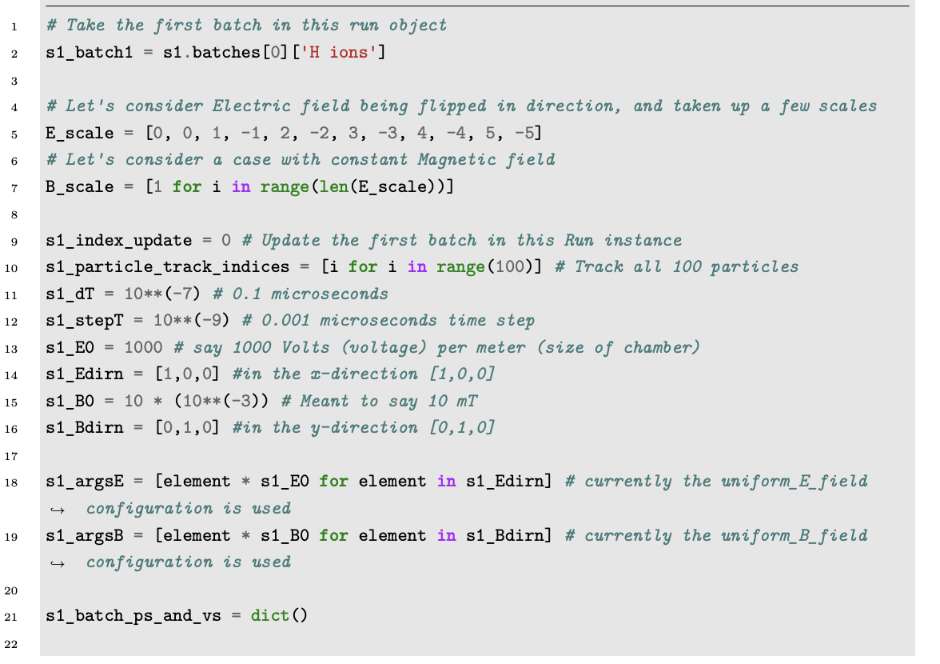
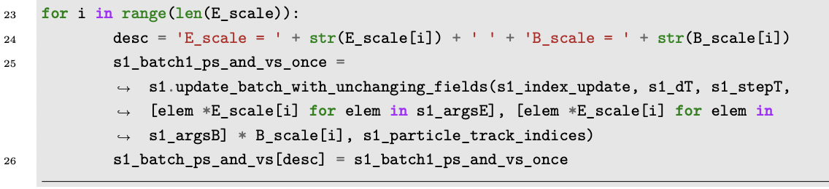
Now we need to extract and arrange the positions and velocities of the particles during the update history and plot them. Let’s first look at the particle at index 0. Let’s first extract the position and velocities of particle zero when the electric field was scaled by +1 and -1 and plot the positions.

Slide 13
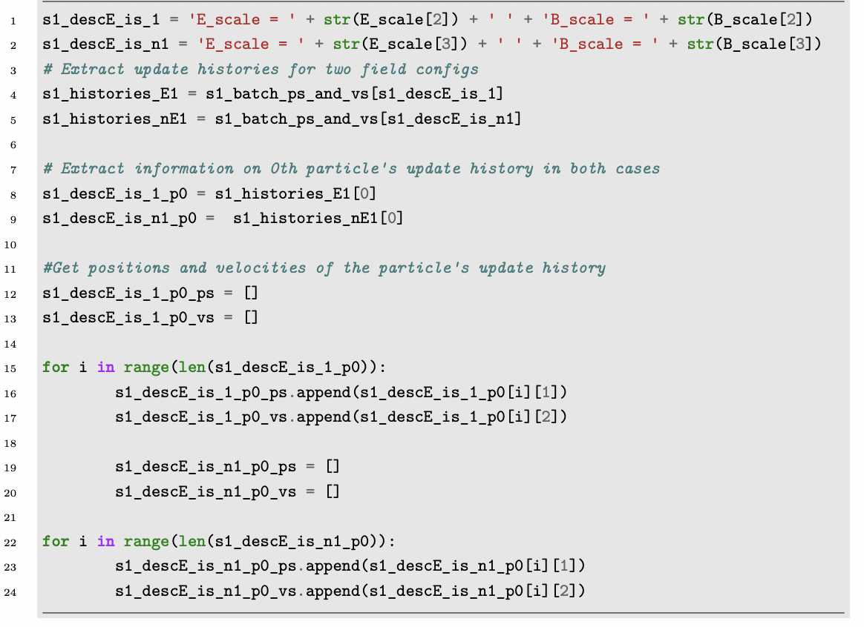
Now we plot the positions of the particle at index 0 when the electric field was scaled by +1 and -1.

Slide 14
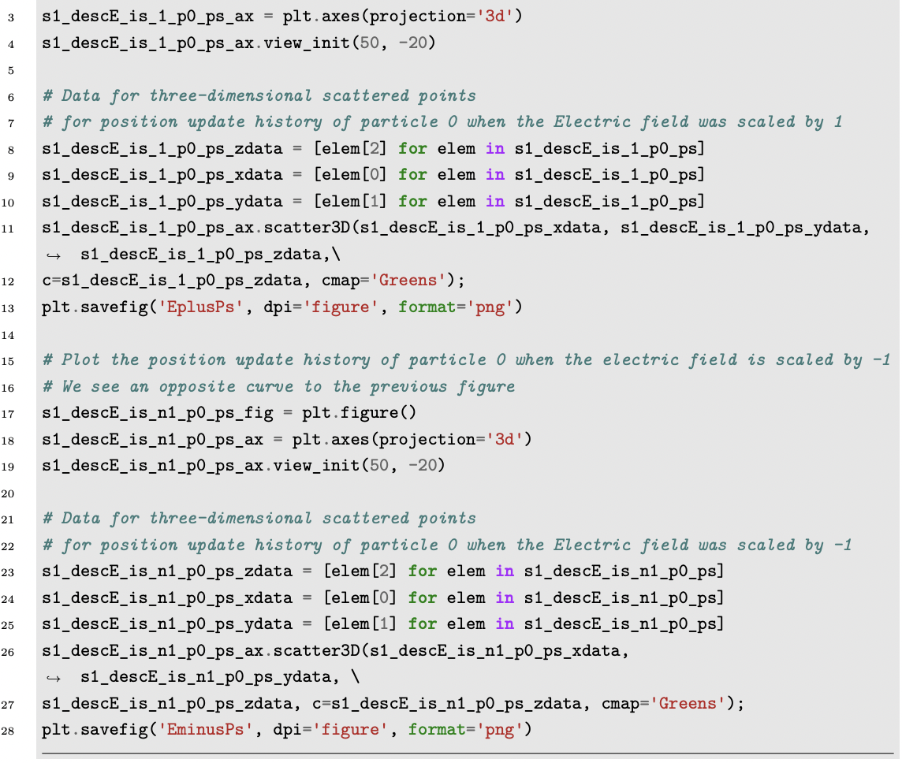
The plots output are as following. All numbers are in meters. In 3-dimensional plots, the vertical axis represents the z-axis, the axis into the page of the plane represents the x-axis and the axis along the lines the page represents the y-axis. In 1 dimensional plots, the vertical axis represents the value being plotted and the horizontal axis represents the steps of iteration.

Slide 15
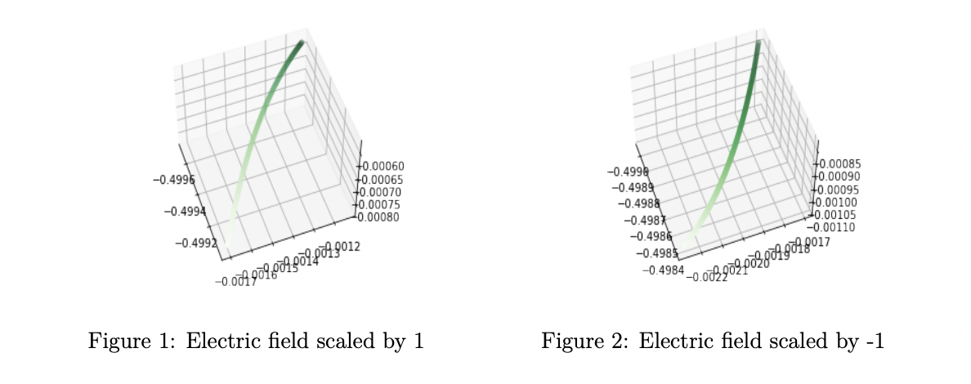
Particle trajectory in opposite Electric Fields

Slide 16
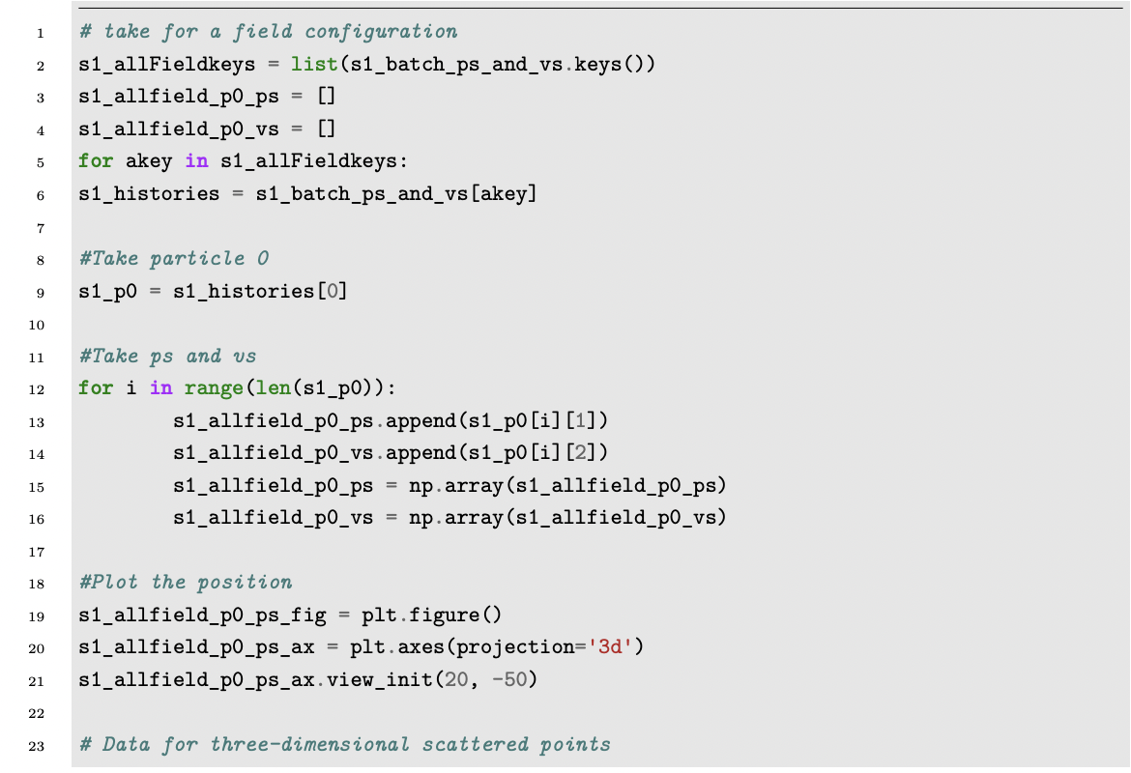
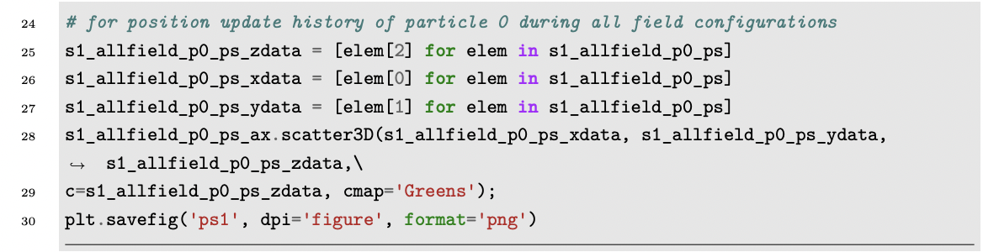
2.2 Plotting particle update history

Slide 17
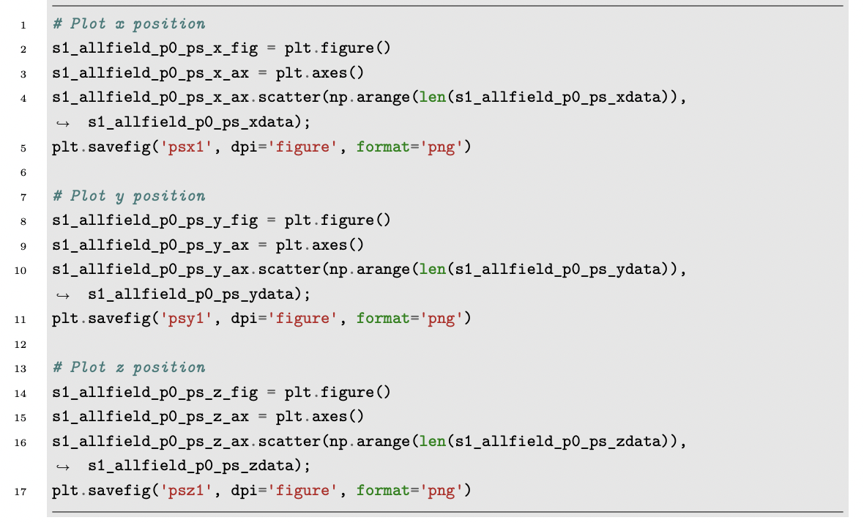
We also plot the x, y and z components of position during the evolution, against the update steps.

Slide 18
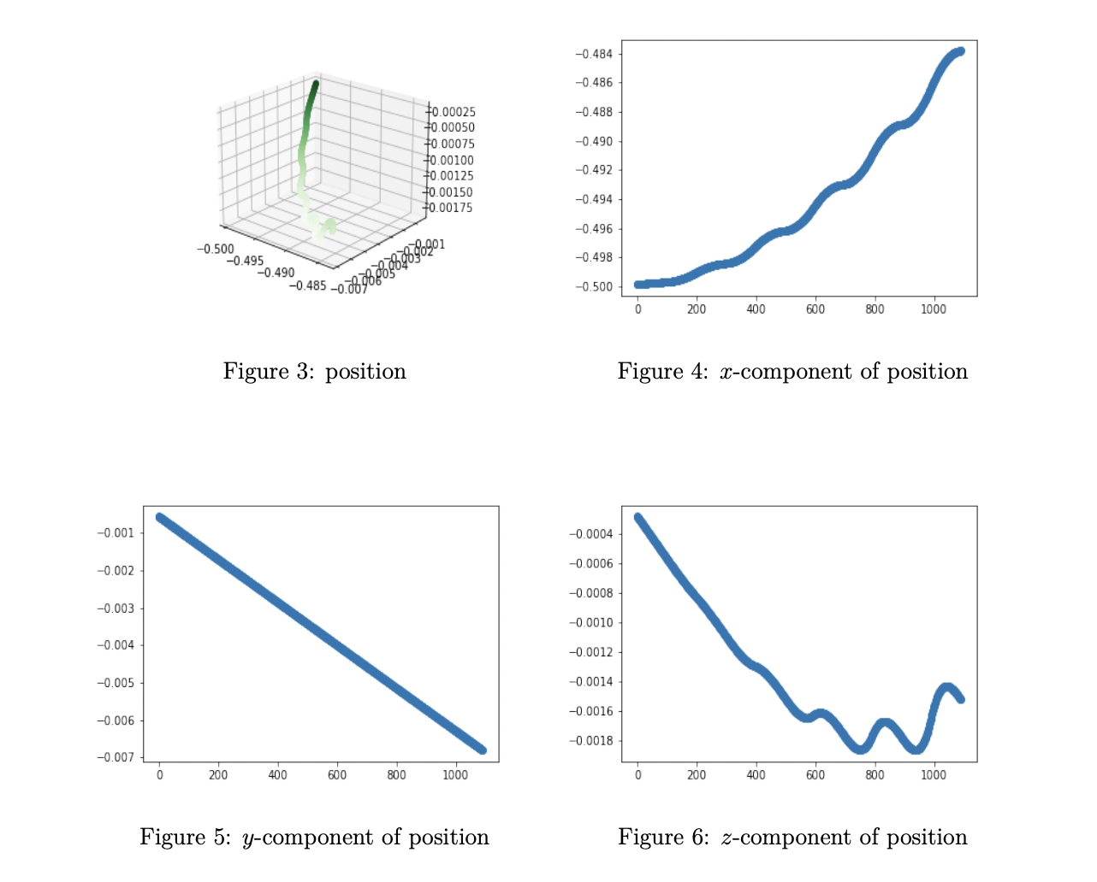
Position and components plot

Slide 19
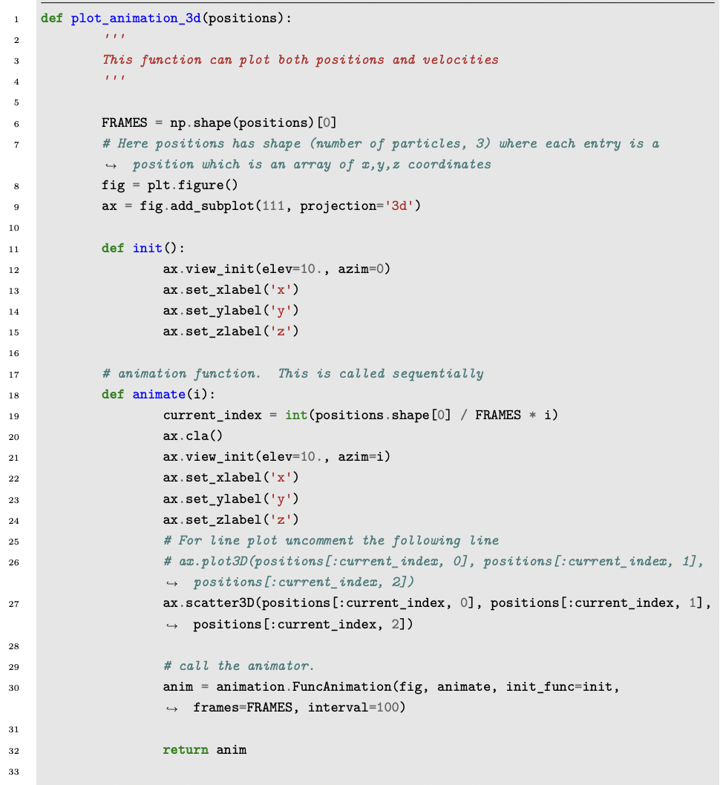
Animations have been generated for all plots and they help us understand these update histories better. Animations were generated using the following parts of the program.
Animation for plots

Slide 20
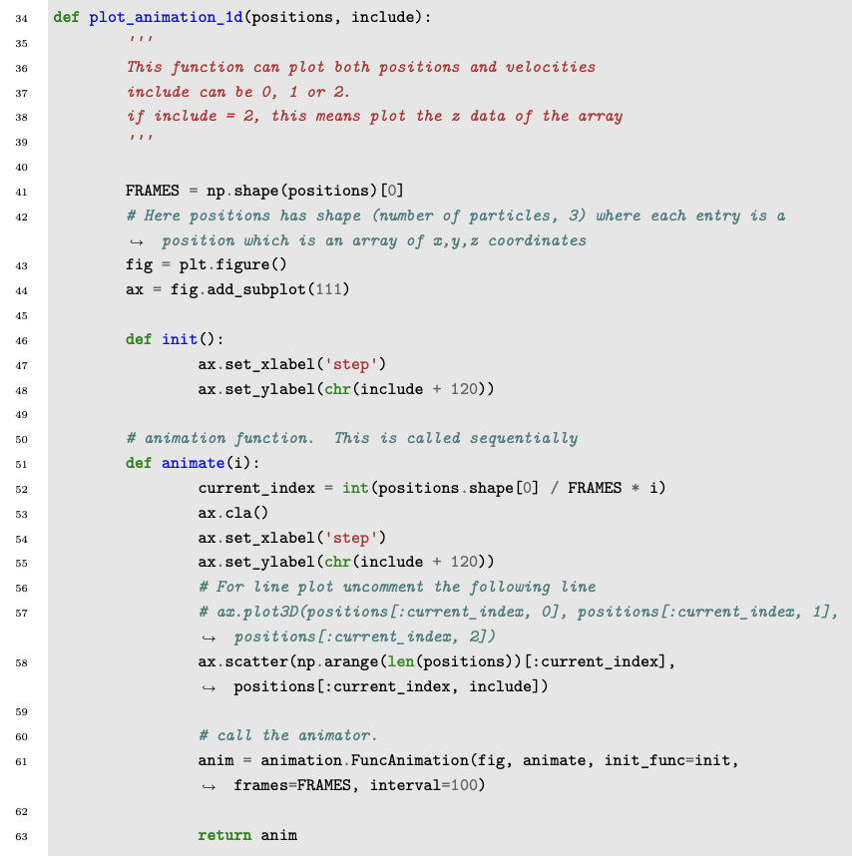

Slide 21
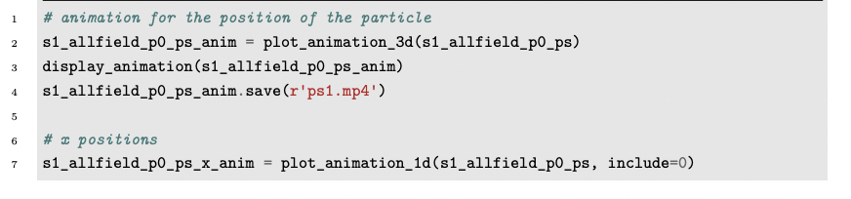
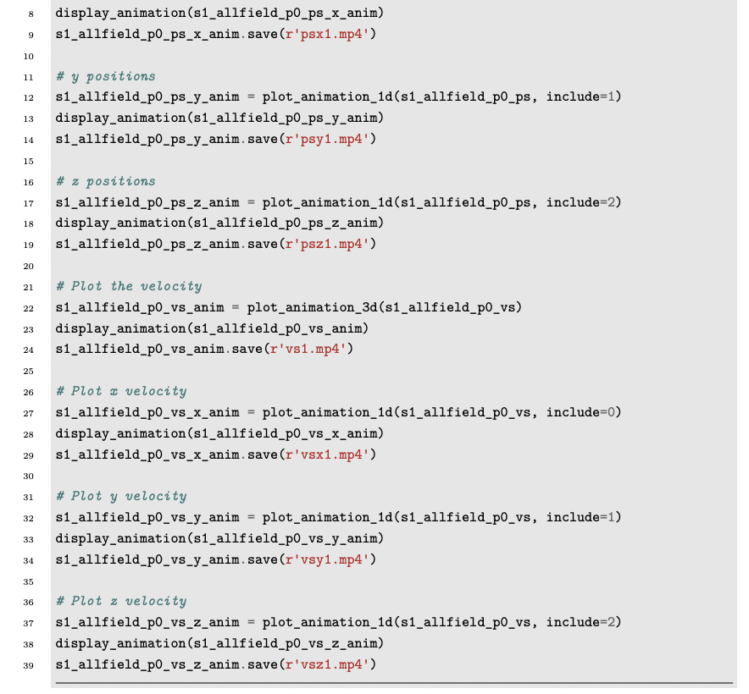
Running the animation generation.

Slide 22
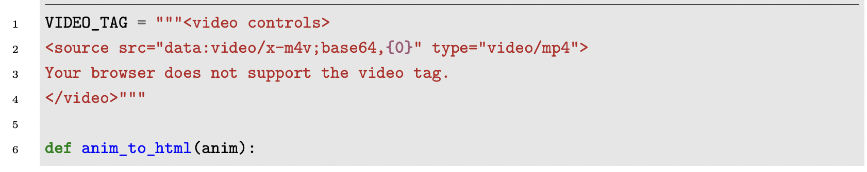
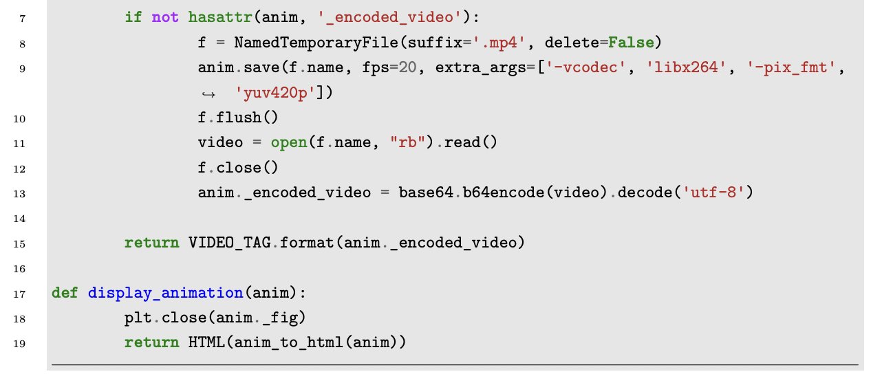

Slide 23
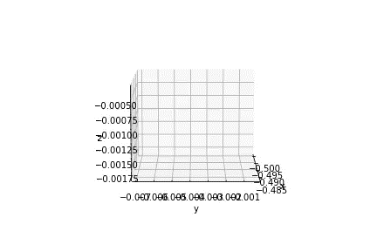
Position animation

Slide 24
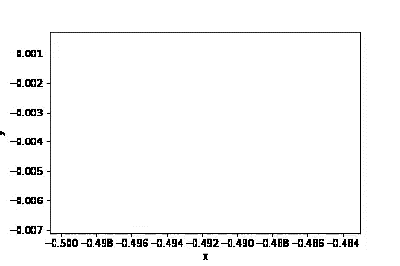
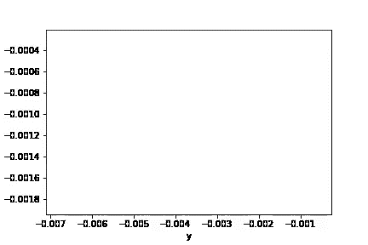
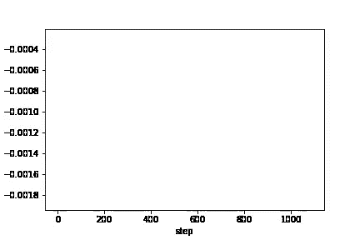
Position animations
Position in x component
Position in y component
Position in z component

Slide 25
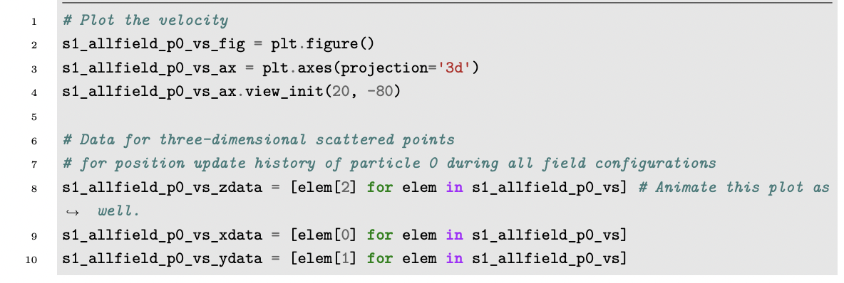
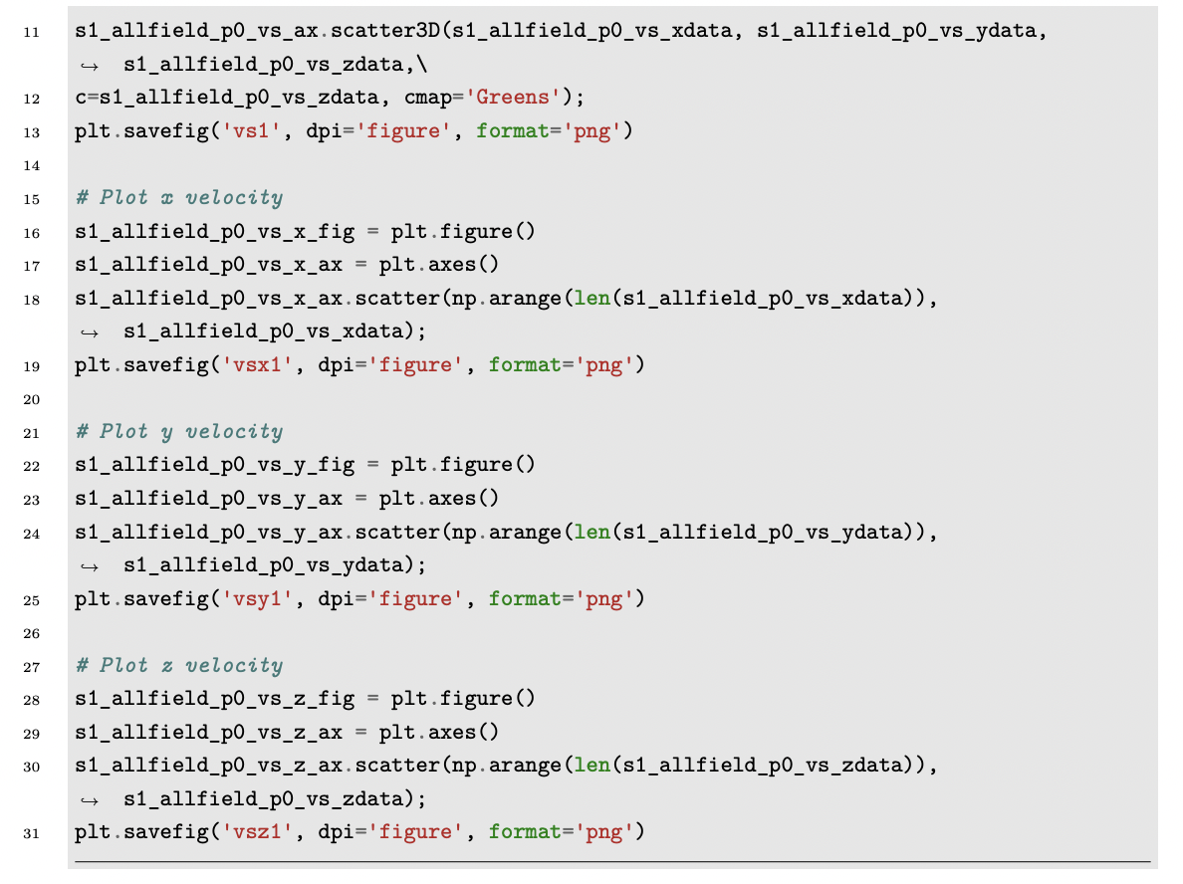
We also plot the velocity and components of velocity of the particle.
2.3 Plotting velocity update history

Slide 26
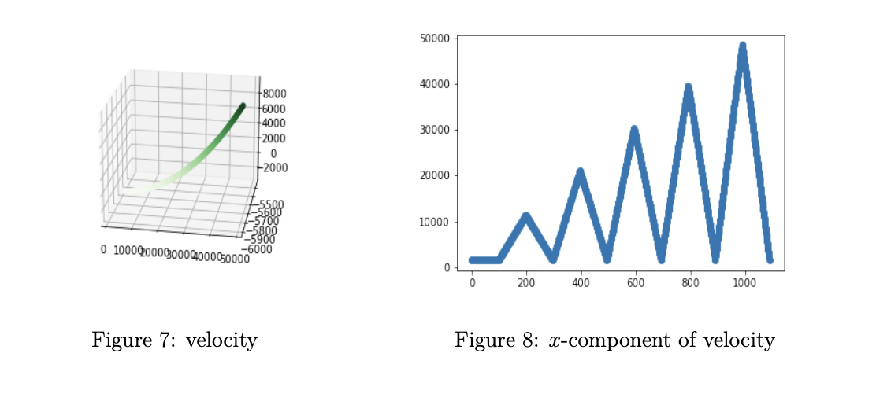
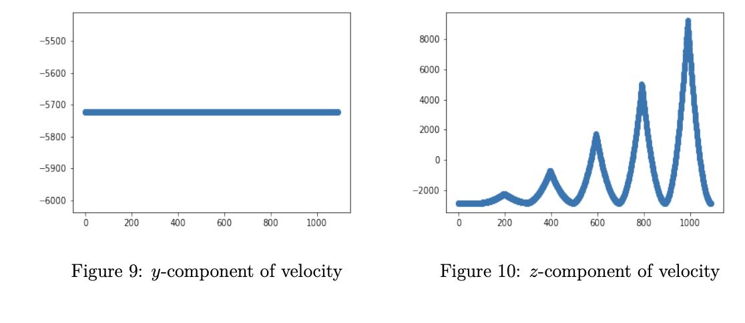
Velocity and components plot

Slide 27
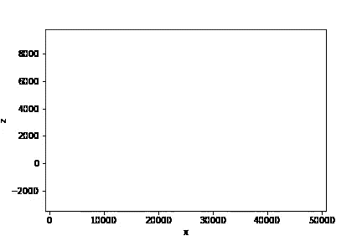
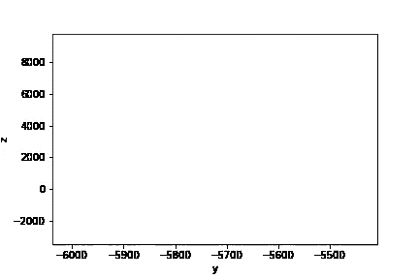
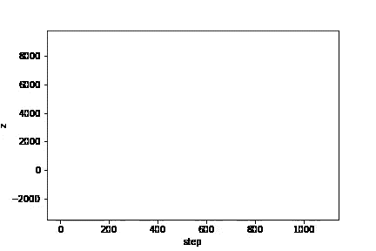
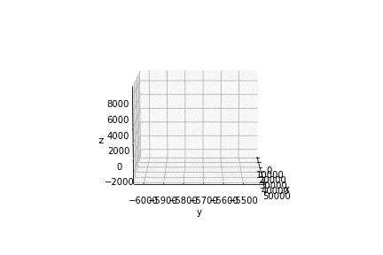
Velocity animations
Velocity in x component
Velocity in y component
Velocity in z component
Velocity in 3D

Slide 28
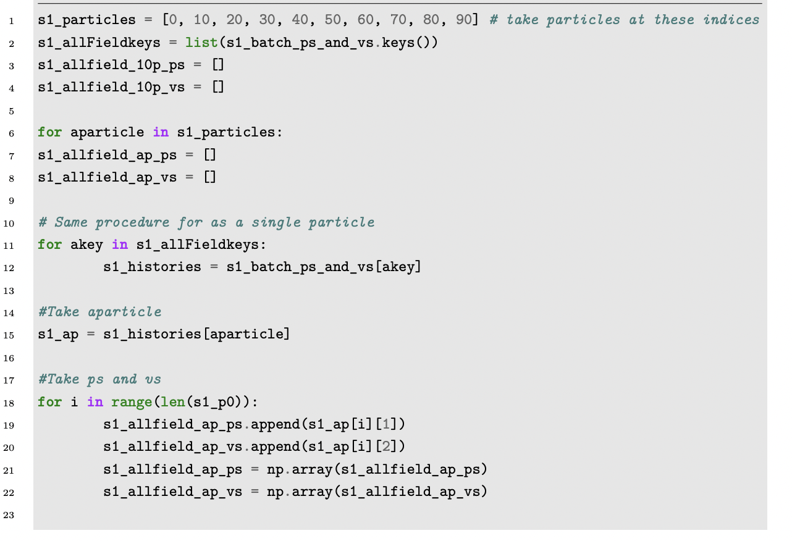
2.3 Multiparticle update plots
We can look at the position and velocity update histories of many particles. We pick 10 particles, the particles at indices [0, 10, 20, 30, 40, 50, 60, 70, 80, 90] to plot.

Slide 29
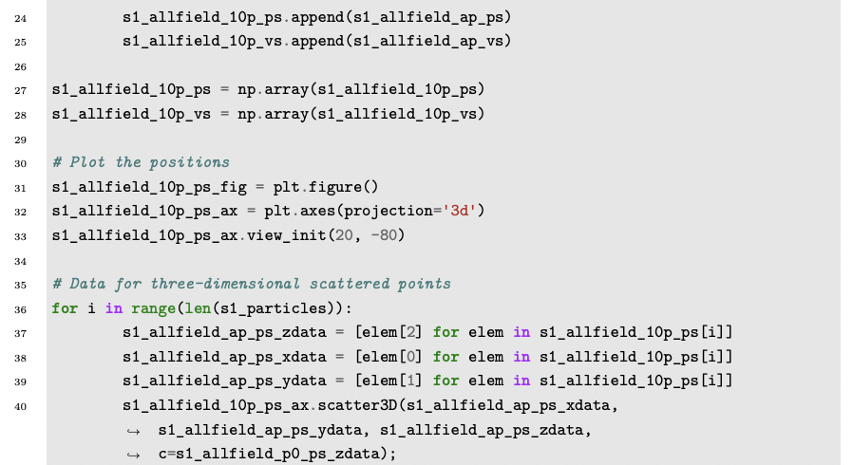
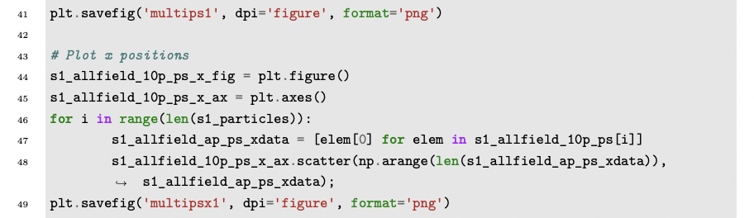

Slide 30
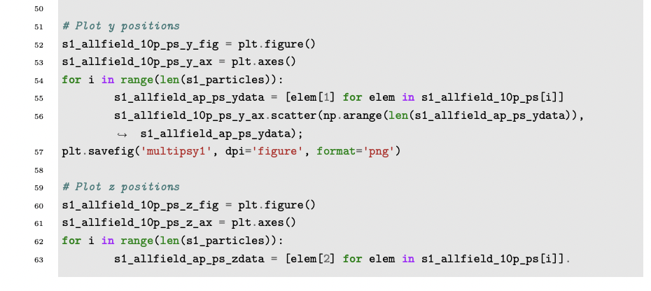
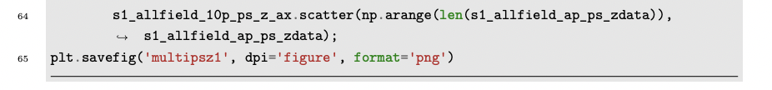

Slide 31
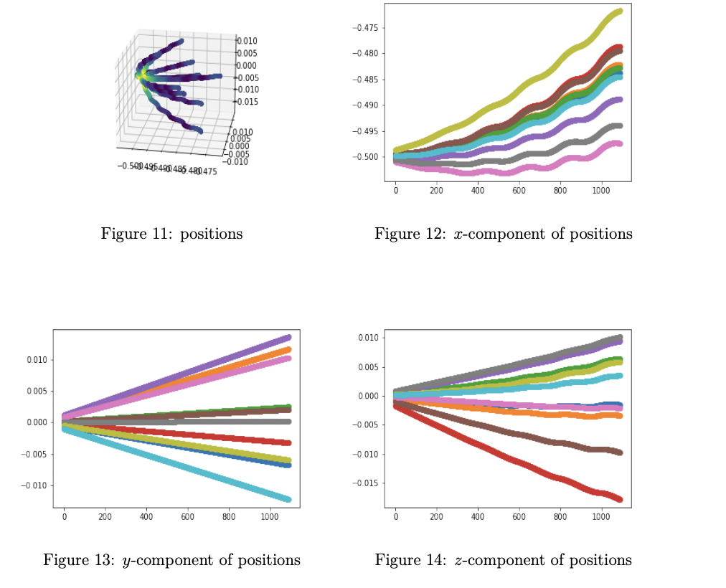
Plots of the positions:

Slide 32
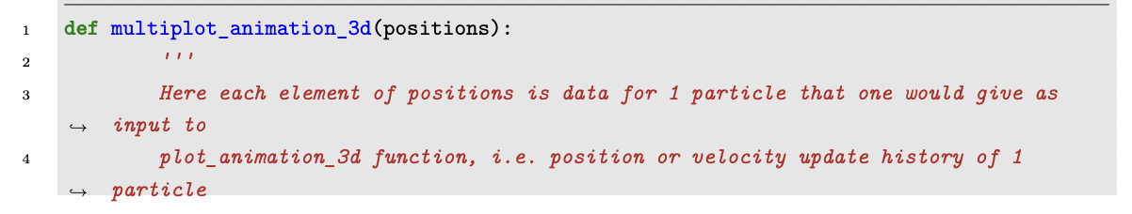
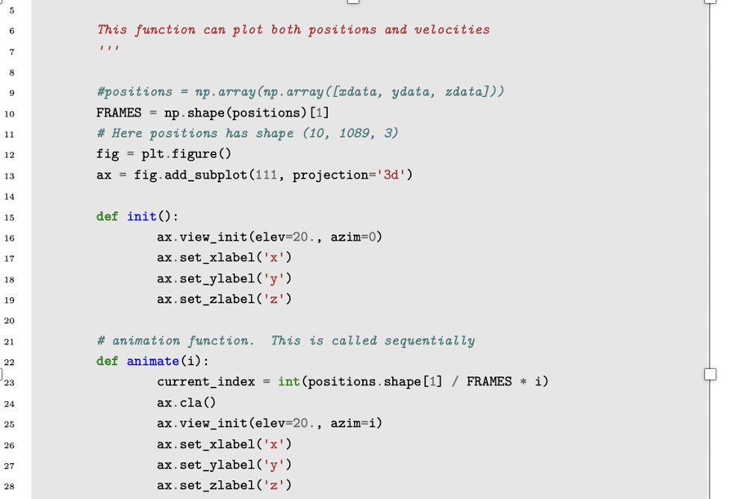

Slide 33
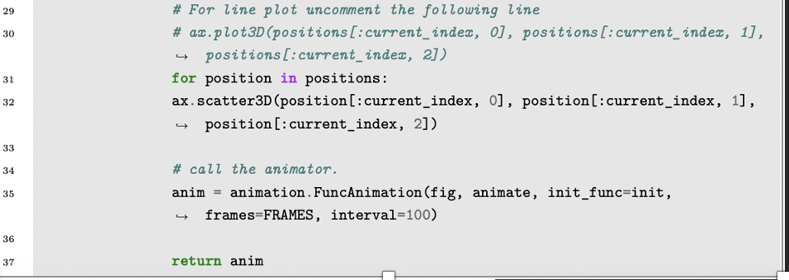
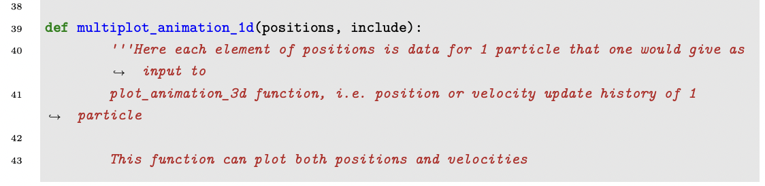


Slide 34


Slide 35


Running the animation generation.

Slide 36

Multiparticle position Animation

Slide 37



Multiparticle position components’ Animation
Multiparticle Position in x component
Multiparticle Position in y component
Multiparticle Position in z component

Slide 38

We can also look at the velocities.

Slide 39


Slide 40

We get the following plots for the velocities

Slide 41


Slide 42

Multiparticle Velocity Animation

Slide 43



Multi-particle Velocity Components Animation
Multiparticle Velocity in x component
Multiparticle Velocity in y component
Multiparticle Velocity in z component

Slide 44
References
[1] Florian LB (GitHub user). Charged Particle Trajectories in Electric and Magnetic Fields. Thu, 28 Jan 2016. https://flothesof.github.io/charged-particle-trajectories-E-and-B-fields.html

